Slide 1
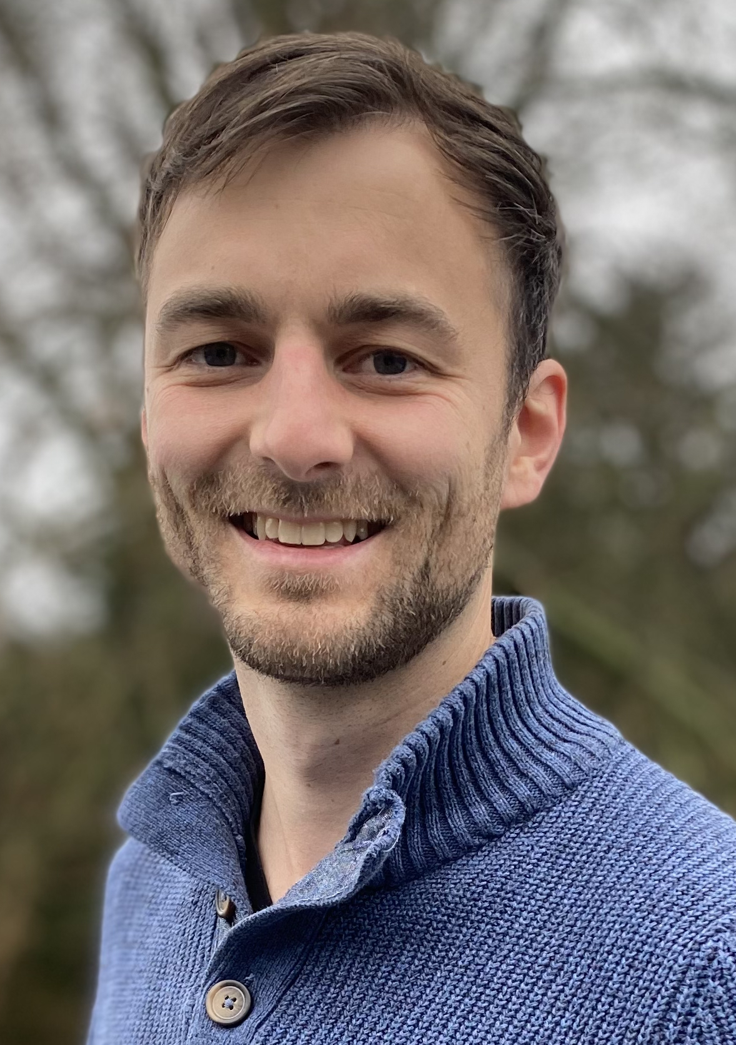
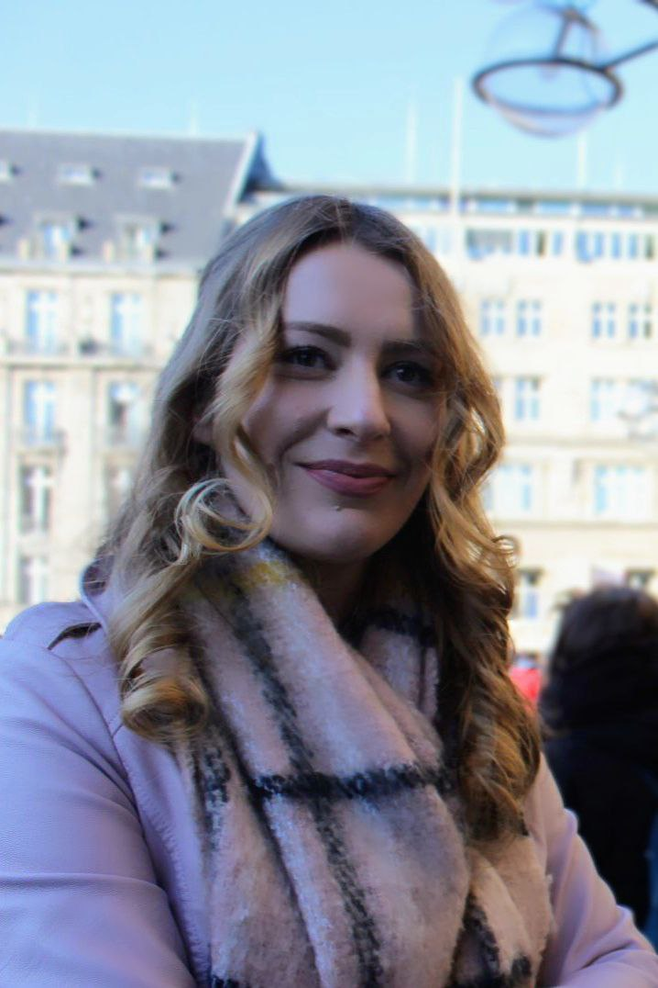
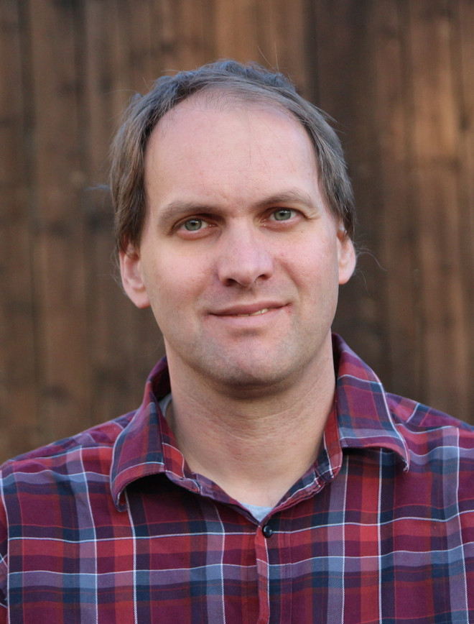
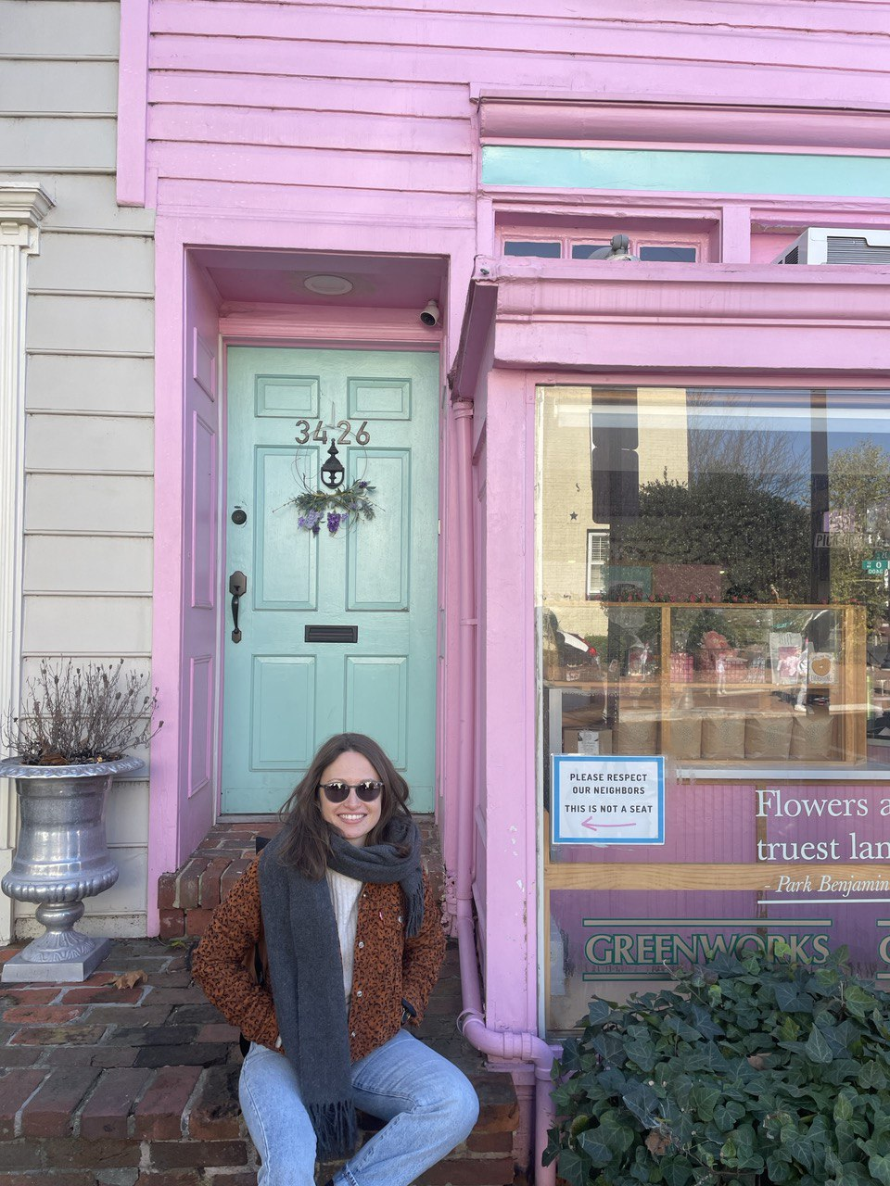
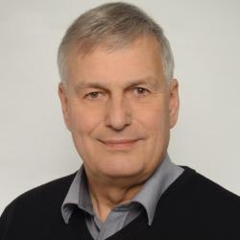

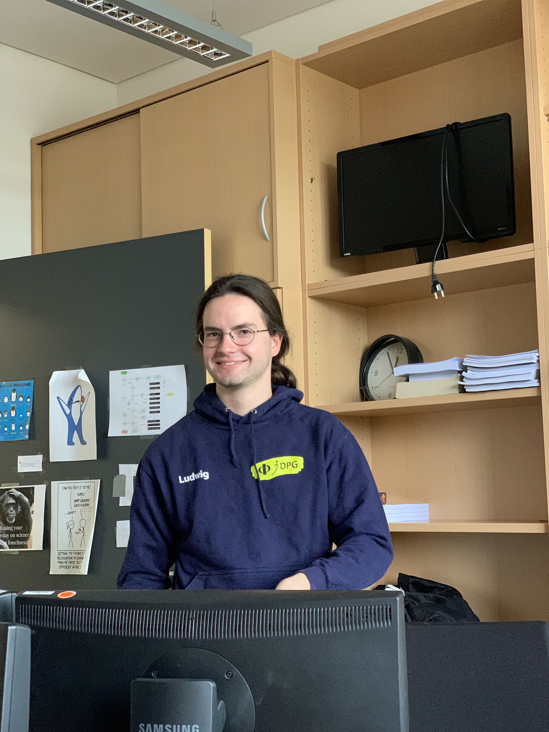
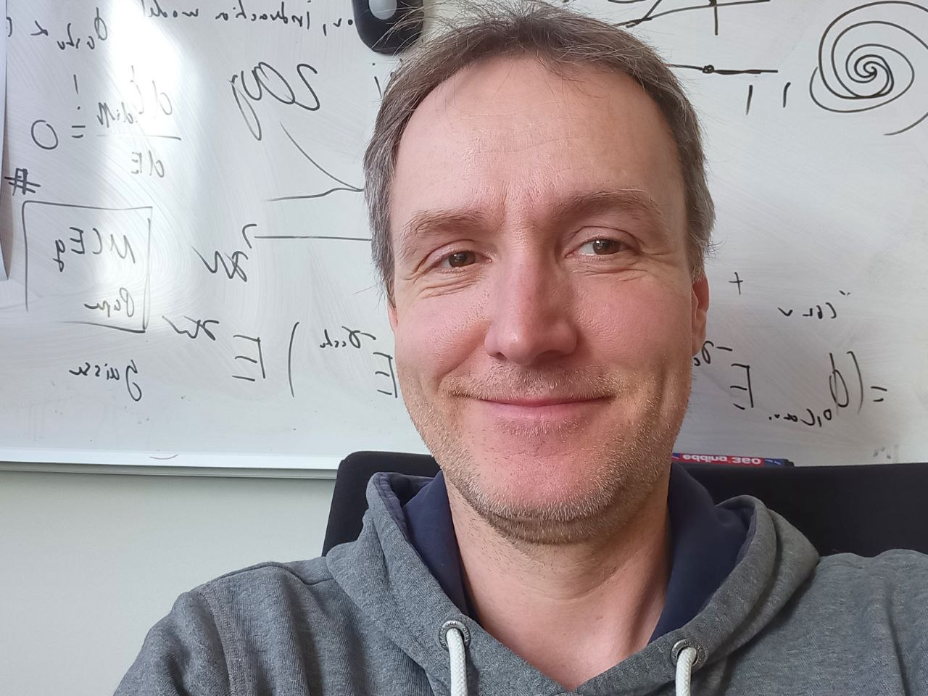
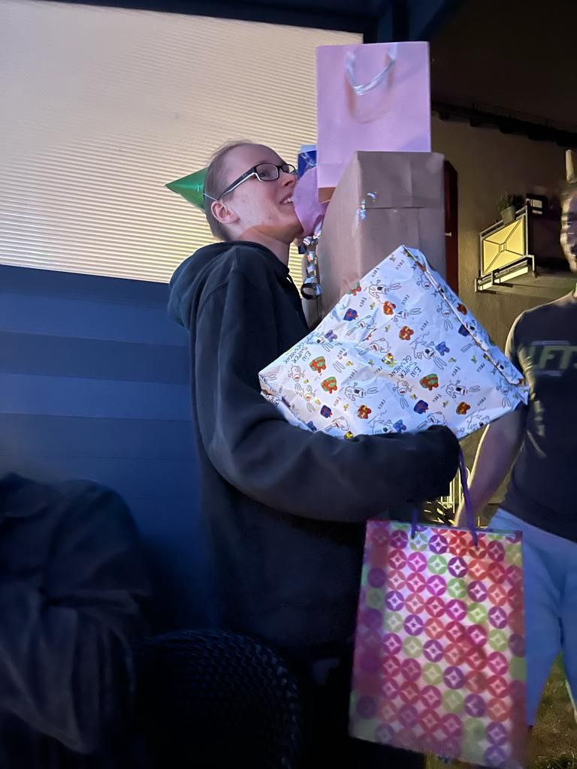
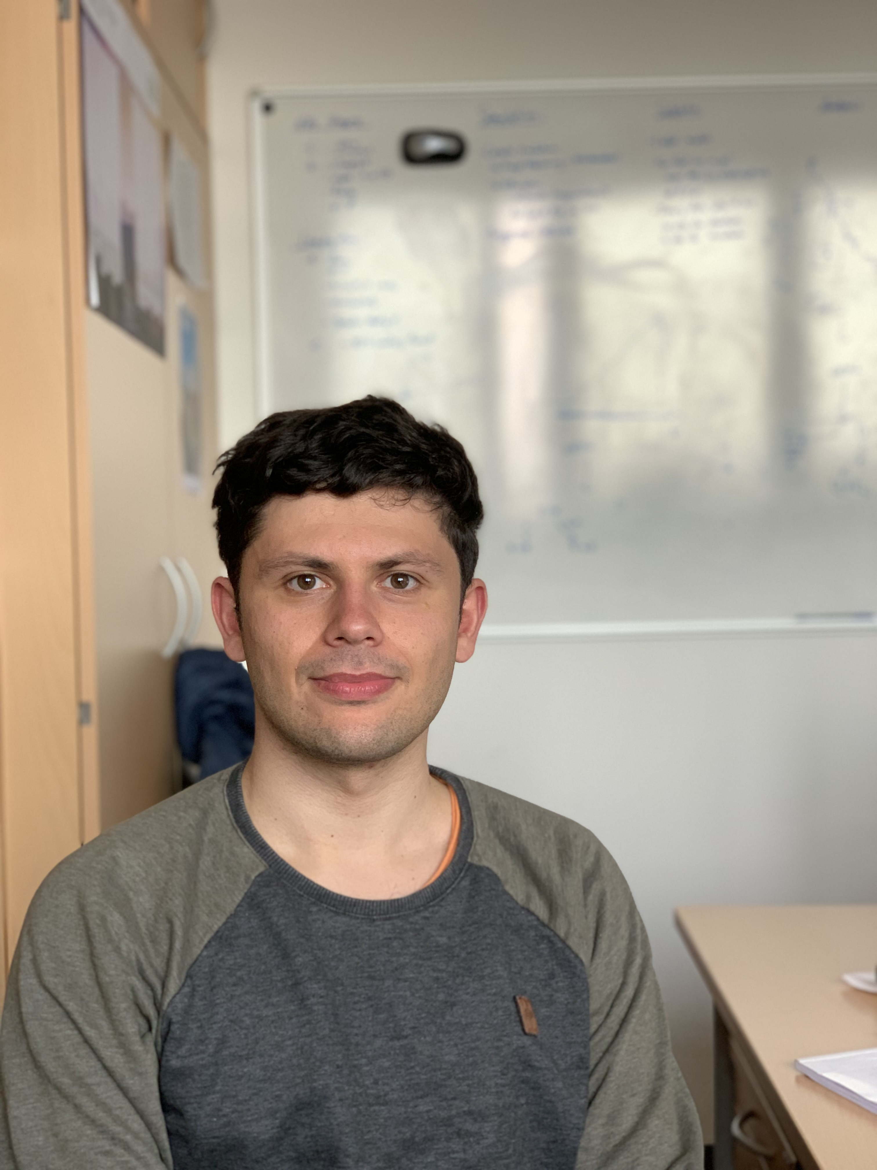
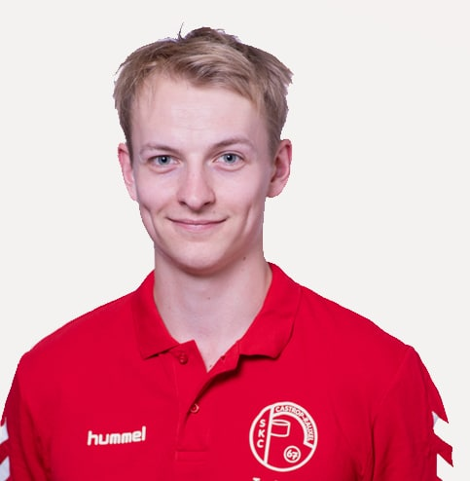
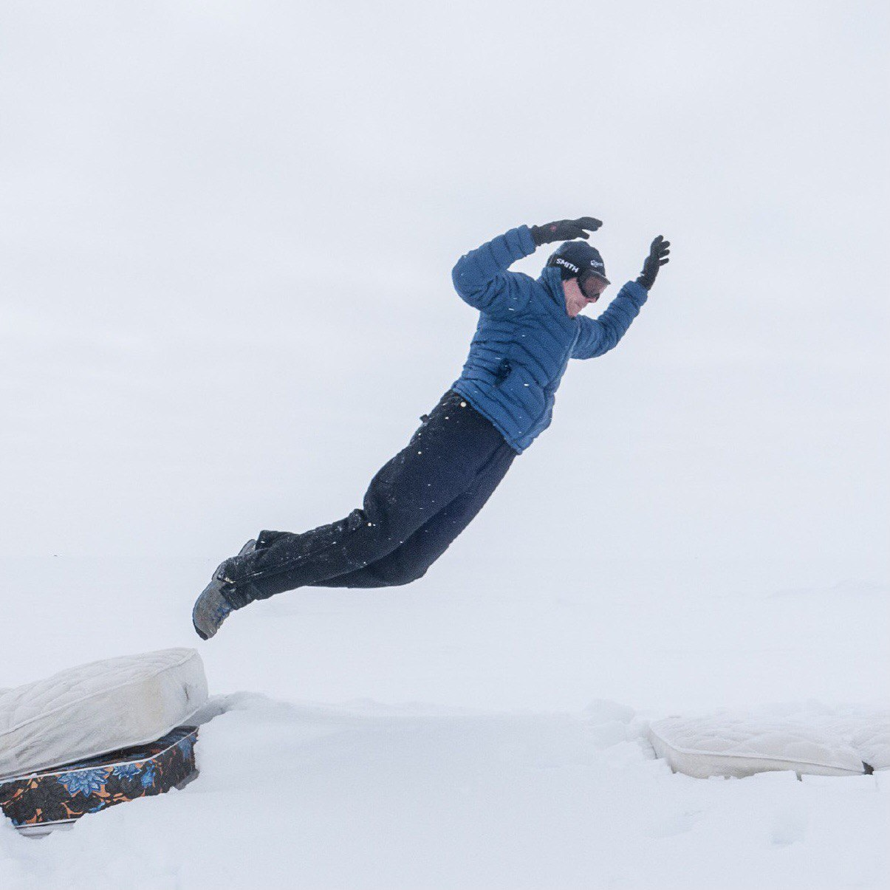
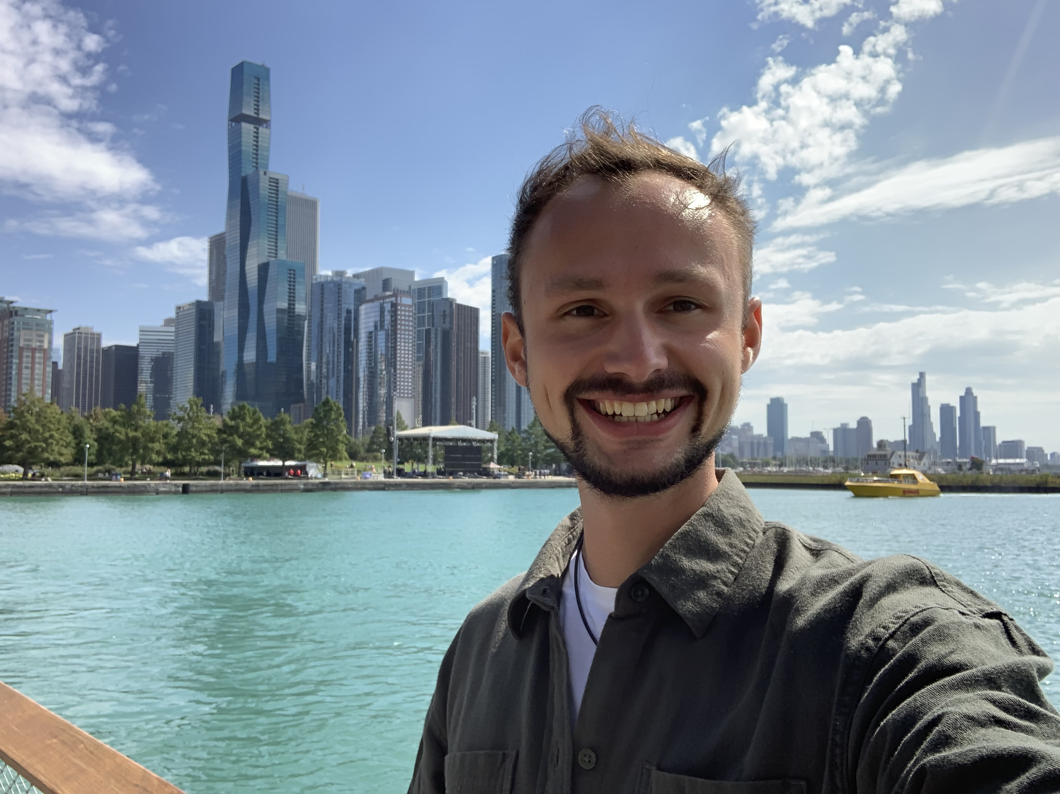
Mirco Hünnefeld
(PhD student)
Leonora Kardum
(PhD student)
Karolin Hymon
(PhD student)
Wolfgang Rhode
(Prof.)
Dominik Elsässer
(Post doc)
Ludwig Neste
(Master student)
Tim Ruhe
(Post doc)
Lucas Witthaus
(PhD student)
Johannes Werthebach
(PhD student)
Janina Bolles
(Master student)
Jean-Marco Alameddine
(PhD student)
Pascal Gutjahr
(PhD student)

Slide 2
